Slide 1


SENTIMENT SCOPE
Analyzing Social Media Emotions

Slide 2
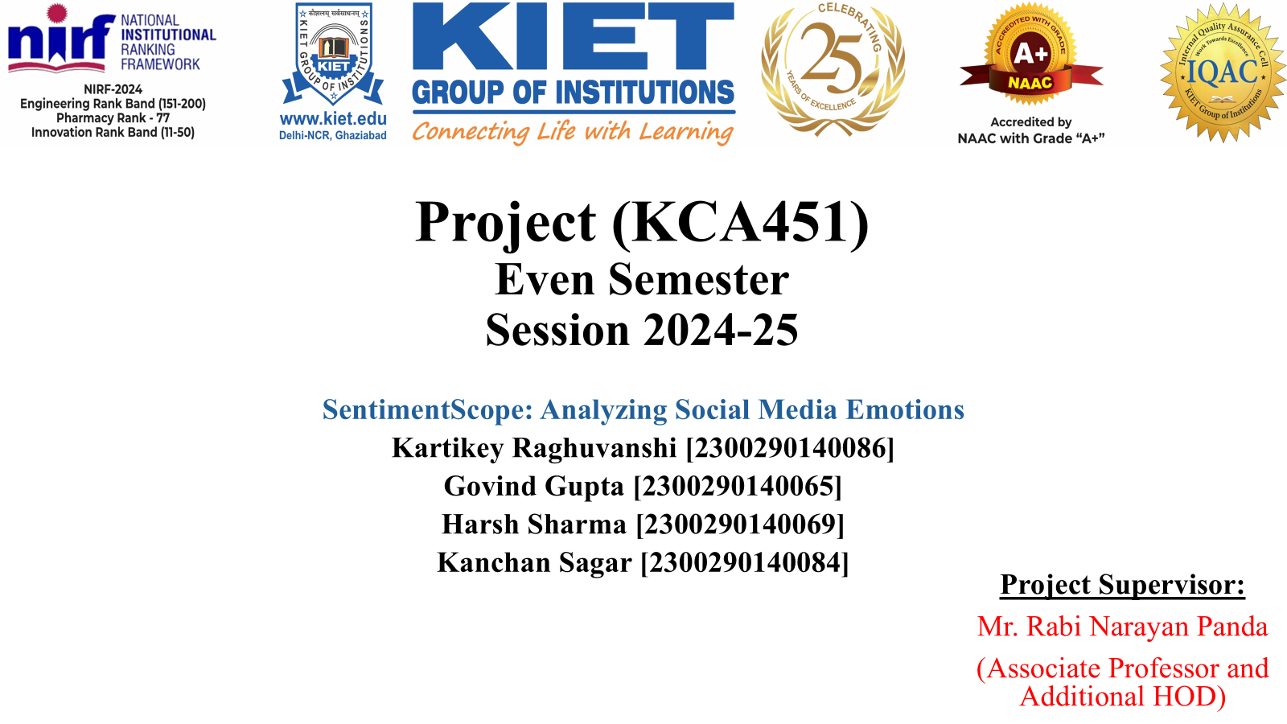

Slide 3

ABSTRACT
Social media is a primary platform for people to express opinions.
Businesses, policymakers, and researchers need sentiment analysis to understand public perception.
This project leverages Natural Language Processing (NLP) and Machine Learning (ML) to classify sentiments.
Data sources: Tweets, product reviews, social media comments (English & Hindi).

Slide 4





PROJECT OBJECTIVE
Improve sentiment classification accuracyusing ML and DL techniques
Support multiple languages (English, Hind, Romanized Hindi)
Enhance business decision-making by tracking sentiments trends
Implement sarcasm detection for better classification

Slide 5
METHODOLOGY
02
04
02
04
Preprocessing
Model Training and Testing
Cleaning text( removing stopwords, punctuations, special characters)
Tokenization and lemmatization (NLTK)
01
03
ML Models: LR, SVM, NB
DL Models: LSTM, BERT
05
Data Collection
Feature Extraction
Evaluation Metrics
Kaggle Dataset, extracting user comments and reviews for analysis
TF-IDF (Term Frequency-Inverse Document Frequency)
Accuracy, Precision, Recall, F1- Score

Slide 6


CHALLENGES
Sarcasm Detection
Multilingual Support
Train separate sarcasm detection model using labeled dataset
Use IndicNLP and Polyglot for handling Hindi ad Romanized Hindi text

Slide 7


TECHNOLOGY
Hardware
Software and Libraries
CPU: Intel i7/ AMD Ryzen 7
Programming: Python (NLTK, TensorFlow, PyTorch)
GPU: NVIDIA RTX 3060
RAM: 16GB+
Frontend: Plotly, Matplotlib, Seaborn
Storage: 500GB SSD

Slide 8

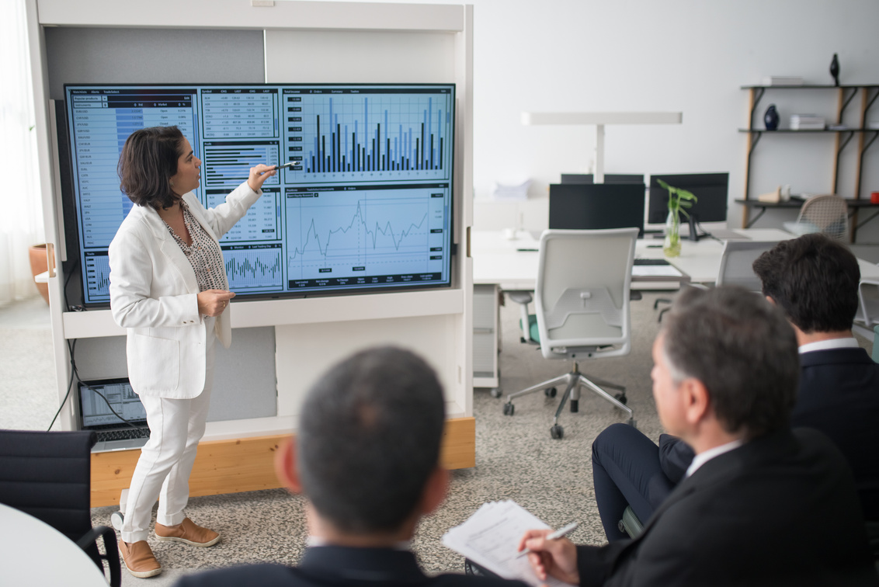



PROJECT OUTCOME
Enhanced Sentiment Classification Accuracy
Support for Hindi and Romanized Hindi
Sarcasm detection for social media text
Scalability (can extend support for multiple languages)
Real-time sentiment monitoring

Slide 9
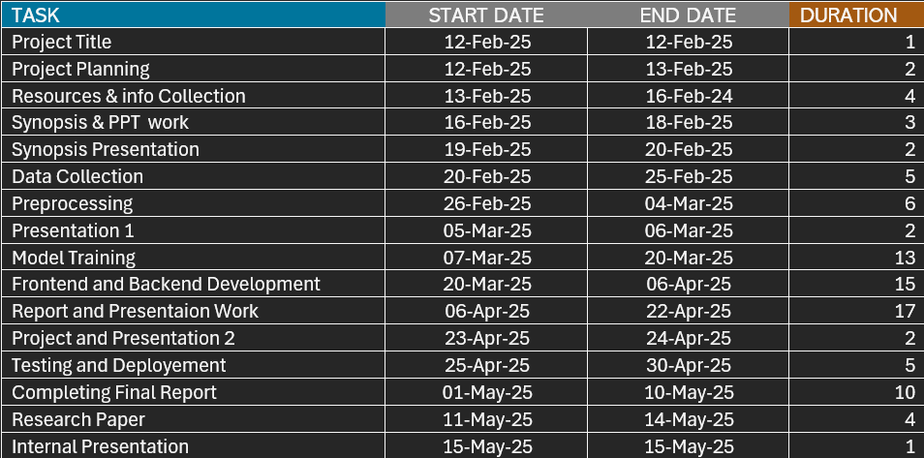
TIMELINE

Slide 10
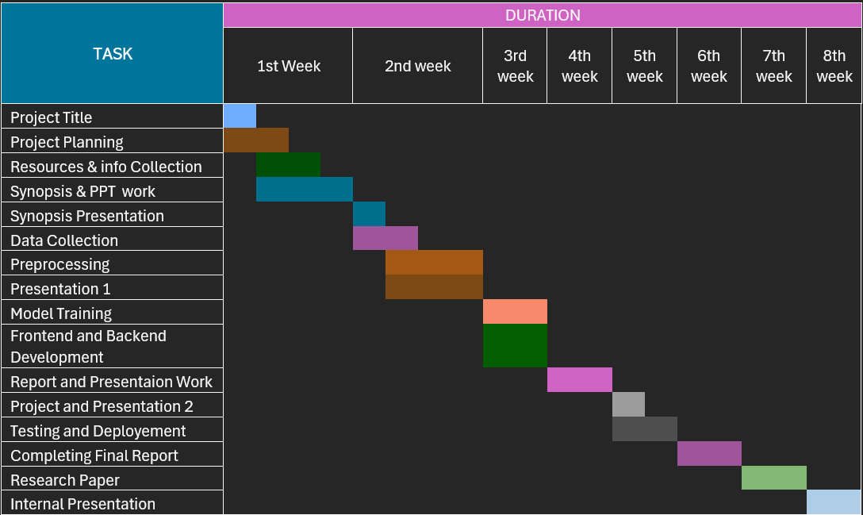
GNATT CHART

Slide 11
FUTURE SCOPE
Extend model to other languages (French, Spanish, regional Indian languages, etc)
Deploy as a web-based sentiment analysis tool
advanced sarcasm detection using deep learning models like LSTM, BERT

Slide 12
THANK YOU !
Any Questions?

